Slide 1
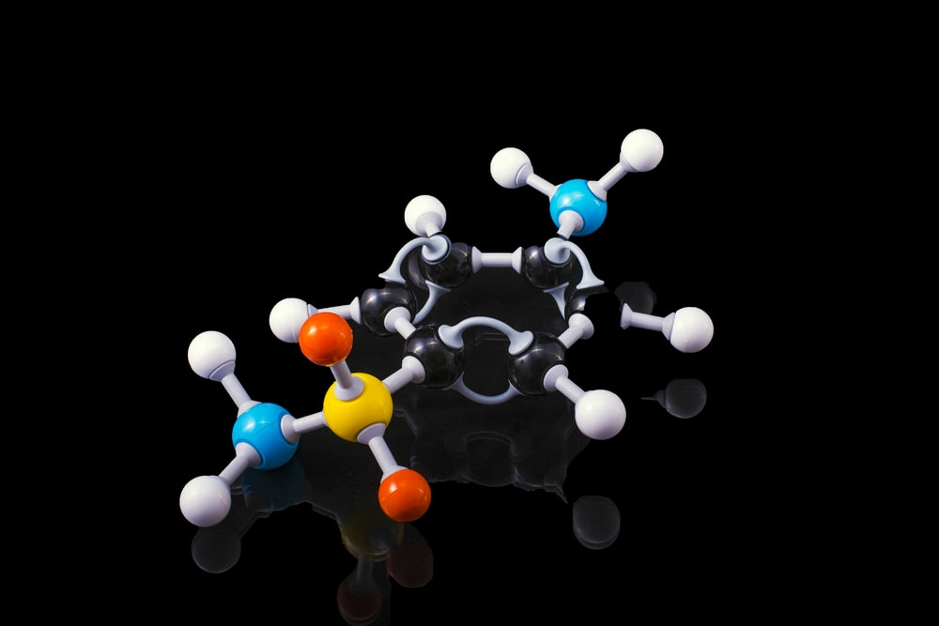

Application of Data Science in Pharma & Healthcare Industry
Anish Mahapatra | 7 September, 2021

Slide 2

Agenda
01
Introduction
02
The Pharma Industry
03
Application of Data Science in Healthcare
04
The Data Science Process Flow
05
Use-cases for Pharma in Analytics
06
Q&A Session

Slide 3










Topic 1 of 6
Introduction
Senior Data Scientist
LinkedIn: www.linkedin.com/in/anishmahapatra Medium: anishmahapatra.medium.com Twitter: @_anishmahapatra
GitHub: www.github.com/anishmahapatra
Q. How to get into Data Science?
A. Simple, ask a real-world Data Scientist.

Slide 4
Topic 2 of 6
The Pharma Industry
01
02
03
Pre-Clinical Phase
Initial Registration
Clinical Trials
Drug Discovery & Design (Clinical Plan) followed by Formulation Design & Regulatory Approval (FDA, EMA)
Registration of API, Regulation of Clinical Trial & Development followed by Risk Management Plan
Phase 1, Phase 2, Phase 3 and Phase 4 followed by evaluation of Marketing Authorization
06
05
04
Post Marketing Survey
Supply Chain Management
Drug Production
Pharma Co-vigilance, Renewal/ Cancellation of Marketing Authorization and further development of the drug
Packaging, Inventory Management, Transportation, Drug Distribution, Track & Trace and Marketing
After successful clinical trials, MAA & NDA approvals, Drug Manufacturing is started

Slide 5
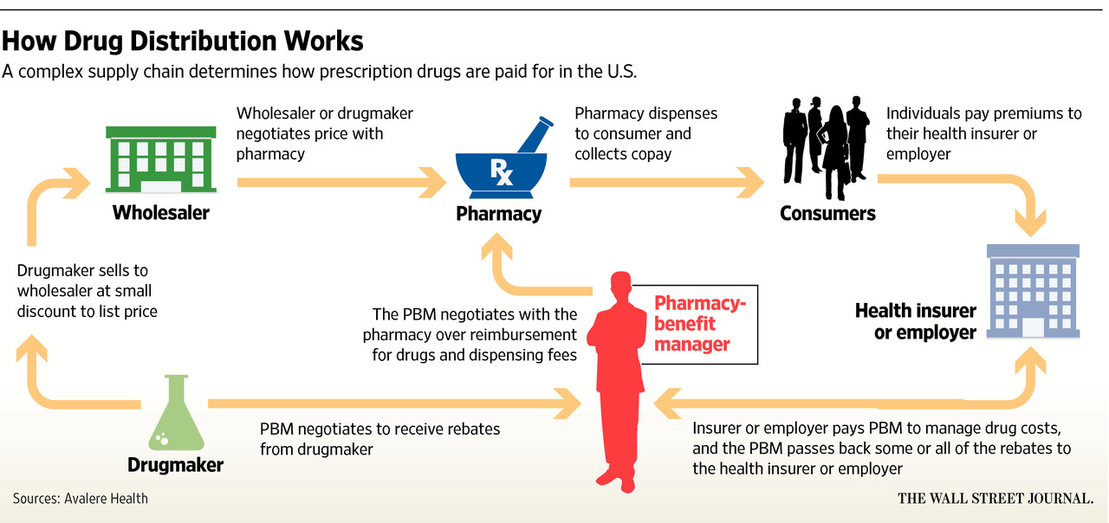
Topic 2 of 6
The Pharma Industry
The Pharma pricing lifecycle

Slide 6
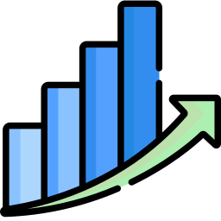

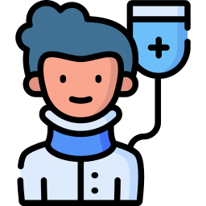
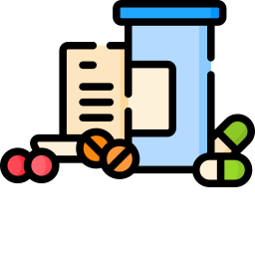
Topic 3 of 6
Application of Data Science in Healthcare
The pharma industry was valued at $390 billion in 2001 and is now worth $1.27 trillion.
The expected CAGR over the next decade is about 11.5%.
Patient
Drugs
Business
Innovation
Advanced RWE driven Analytics
Risk Monitoring using Digital Health (IoT)
Electronic Medical Records (EMR)
Yield Optimization
E2E Digital Twin simulation
Explainable AI (XAI)
Market Mix Modelling
Real-time predictive analytics
Commercial-spend optimization
Rapidly personalized content
Agent Based Modelling
Intelligent Search System
Notes:
Source:

Slide 7
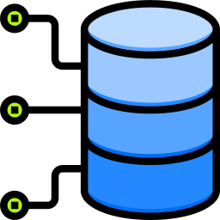

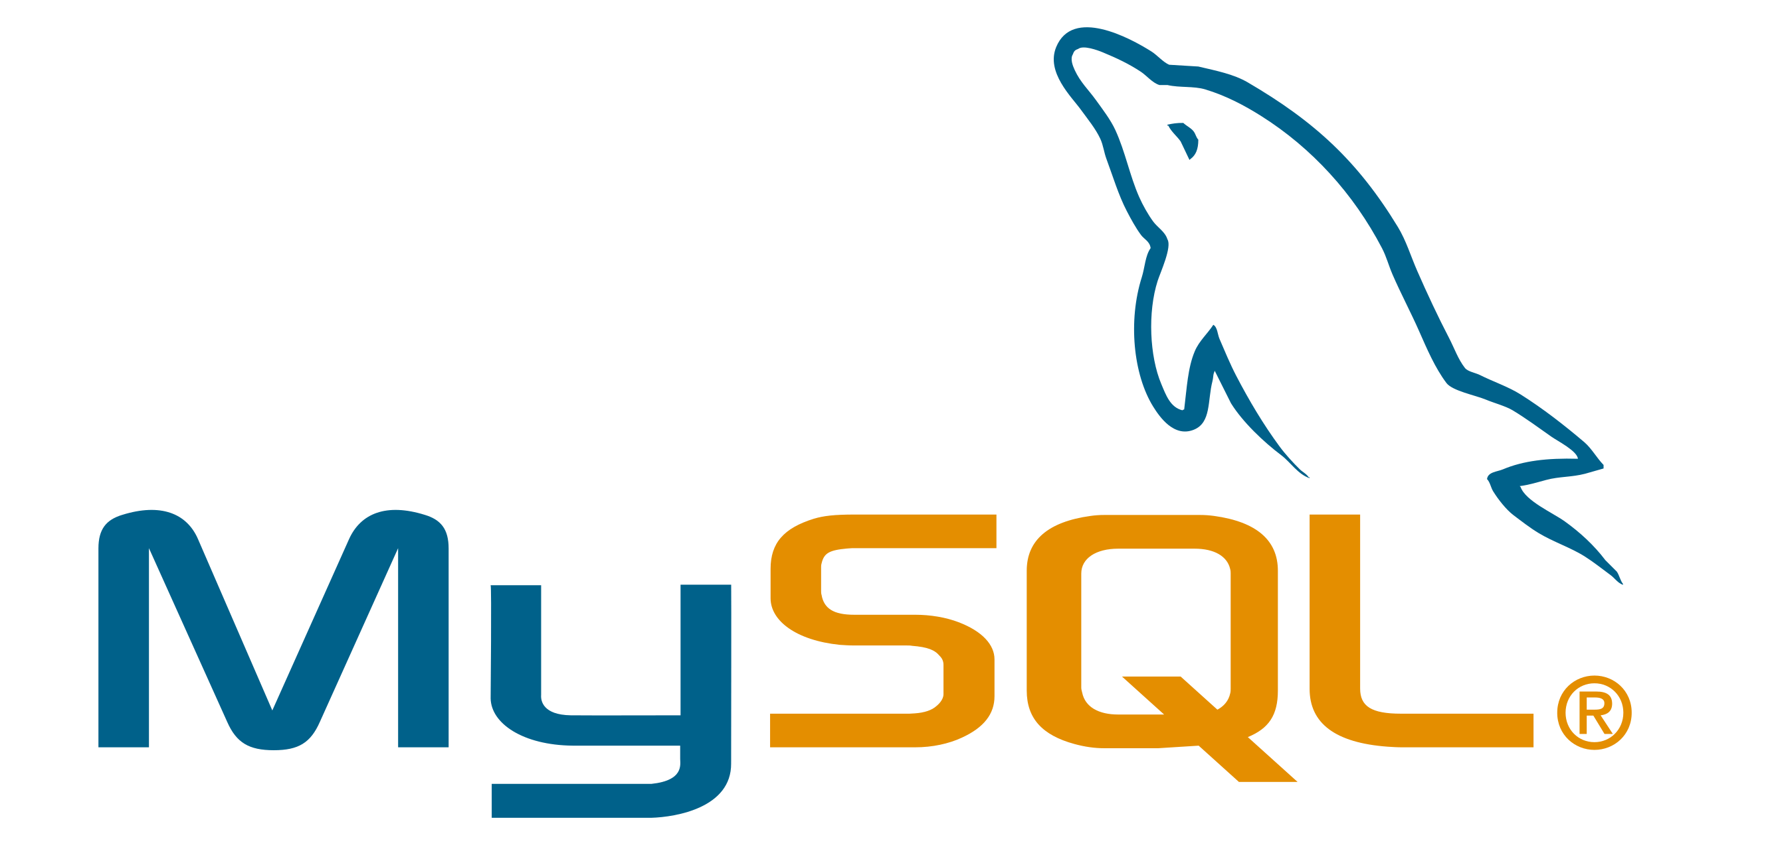

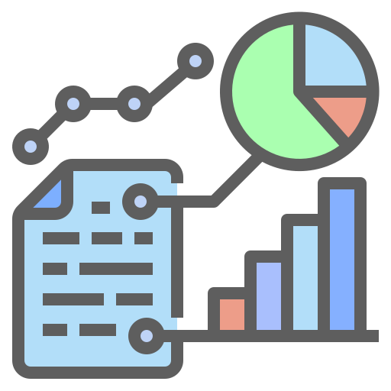

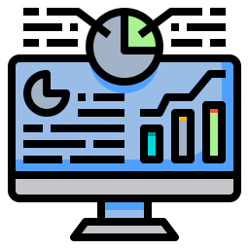
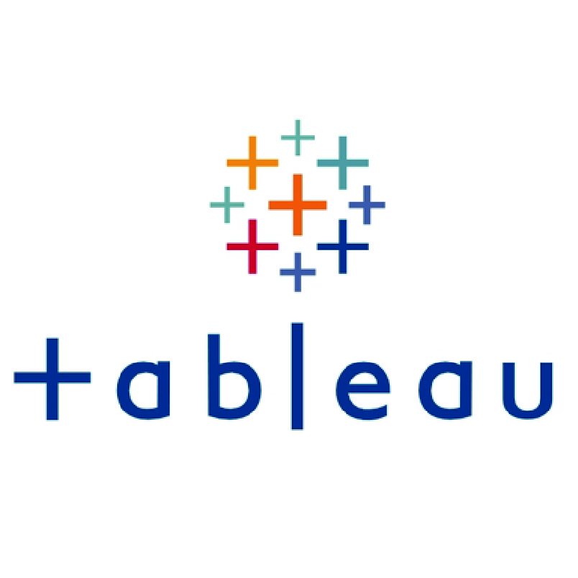
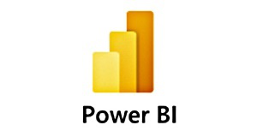









Topic 4 of 6
The Data Science Process Flow
1 Get Data from Data Silos
6 Impact Analysis
Bring data from data silos to data warehouses (ETL)
Data Science is experimental. Fail fast and build faster to maximize profit
2 Understand what the business does
5 Present to the
Business Stakeholders
The business already does things a certain way. First, match the business to show business impact
Analytics is only helpful to the business if it helps them make money. Data Science is Business, Mathematics & Technology.
3 Data Engineering
4 Machine Learning
Orchestrate and build pipelines to automate the process
Models are of three main types: Heuristics-based, Statistical or AI/ML

Slide 8






Topic 5 of 6
Use Cases for Pharma Industry in Analytics
Accelerate Drug Discovery & Development
Reduce Cost & Increase Drug Utilization
With the patents of blockbuster drugs expiring, pharma companies are looking to accelerate time to market leveraging innovation
Granular cost of key metrics will help pharmaceutical businesses to make smarter decisions based on past performance
Personalized & Targeted Medicine
Effective Sales & Marketing
Personalized medicine based on unique genomics to create more effective solutions for users’ problems
An optimized marketing mix spend along with close-range tracking of sales can help make better & faster decisions
Increase Efficiency of Clinical Trials
Data Mining to capture Data of Interest
Leveraging multiple demographic and personalized data points can help accelerate the tedious process of clinical trials
Capturing competitor and product details can help the healthcare industry react better and plan for the future

Slide 9

Application of Data Science in
Pharma & Healthcare
Anish Mahapatra
Q&A Session
Anish Mahapatra
LinkedIn: www.linkedin.com/in/anishmahapatra
Email: anishmahapatra01@gmail.com

Slide 10
Application of Data Science in
Pharma & Healthcare
Anish Mahapatra
Q. How to get into Data Science?
A. Simple, ask a real-world Data Scientist.
Email: anishmahapatra01@gmail.com
Thank you.

